Slide 1
Travel Mate
Team Krafterz
Miracle D’souza
Sushmitha A.A.
Rahul D’costa
Kiran Chitivolu
G R, Annapurna
Notes:
Note: Please View Deck in slideshow mode

Slide 2
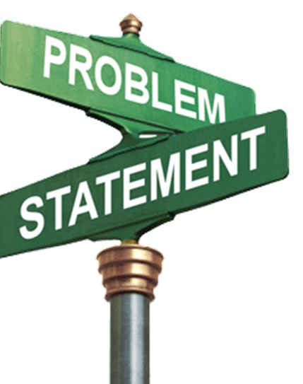
Problem Statement
Booking confirmation is not the end of a hotel Traveling experience
Travelers experience many challenges from the time they land at hotel till the time they check out

Slide 3

Idea
To develop an application which will cater to the time consuming problems faced by traveler post hotel booking
Virtual key as single entry point
Intuitive Hotel Services Menu
Pre-verification of ID proof documents
Touchless check-in & check-out process
Pre-allocation of hotel rooms
Bringing to you a more Secure ,Hassle-free Hotel Traveling Experience and a less human intervene process through Travel Mate

Slide 4

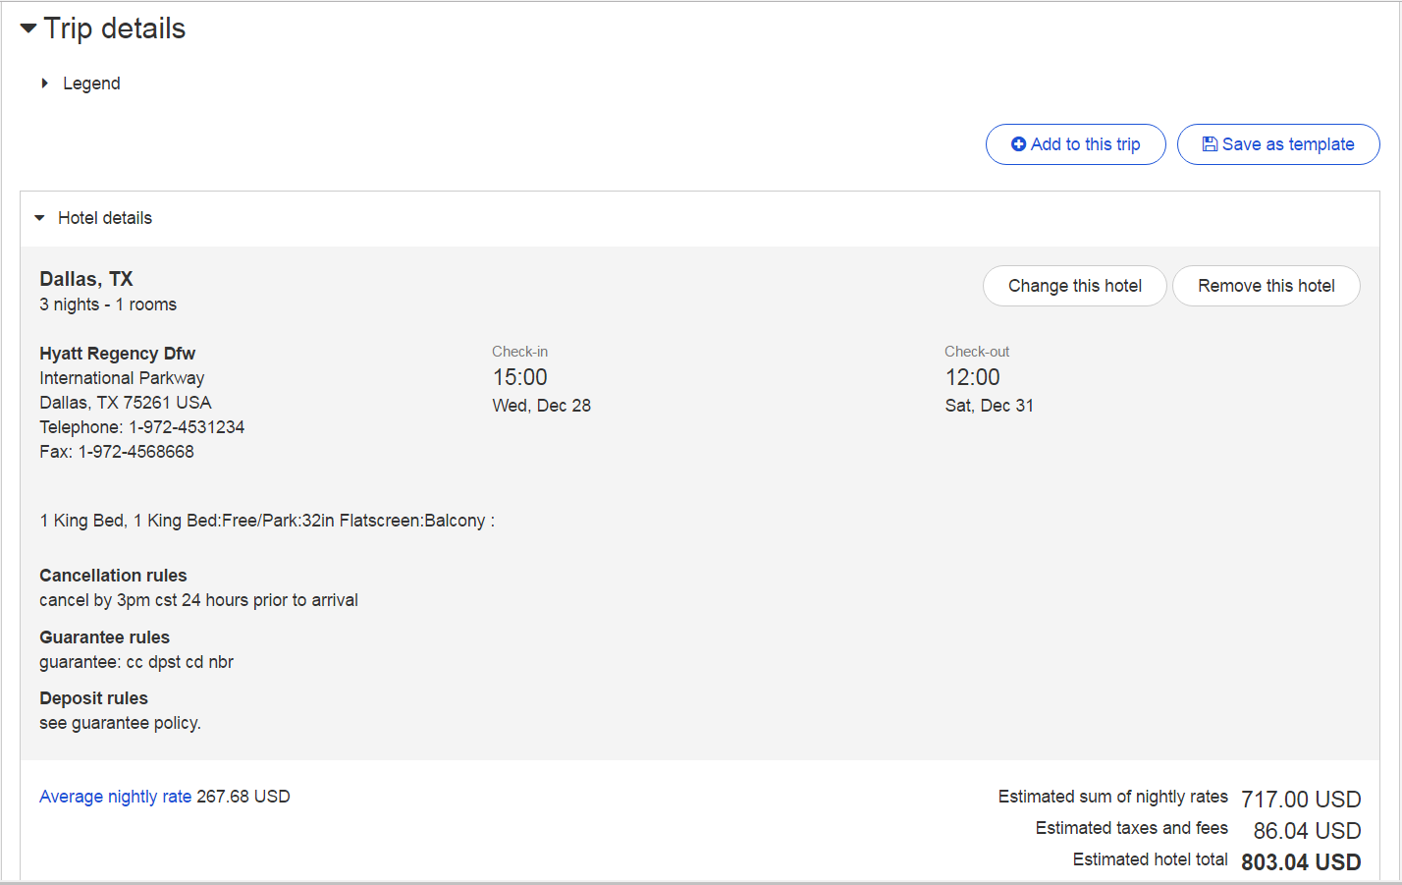

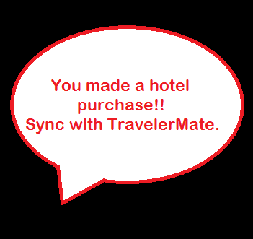
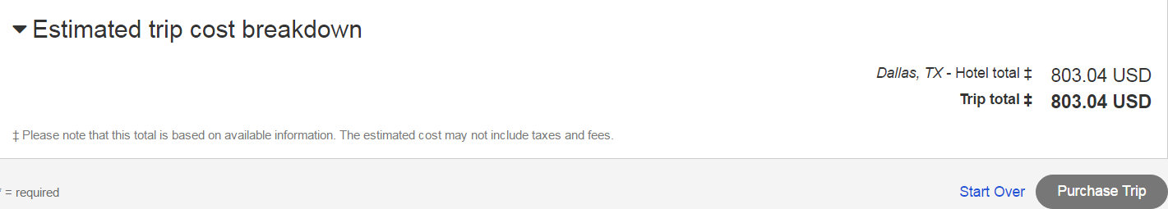


The New Hotel Travel Experience
No
Yes

Slide 5

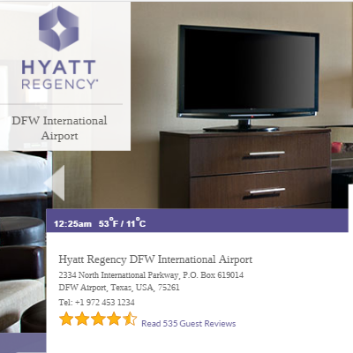


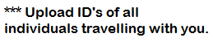
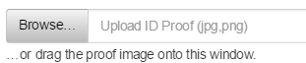
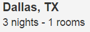



Pre- Verification of Document

Slide 6
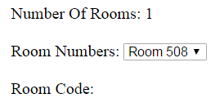


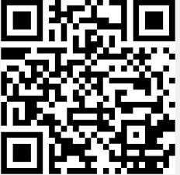

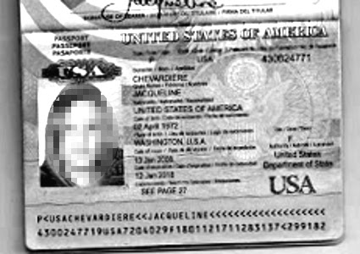

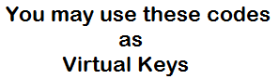
Pre- allocation of Hotel Room & Virtual key generation

Slide 7
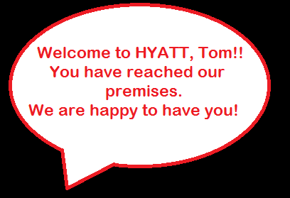
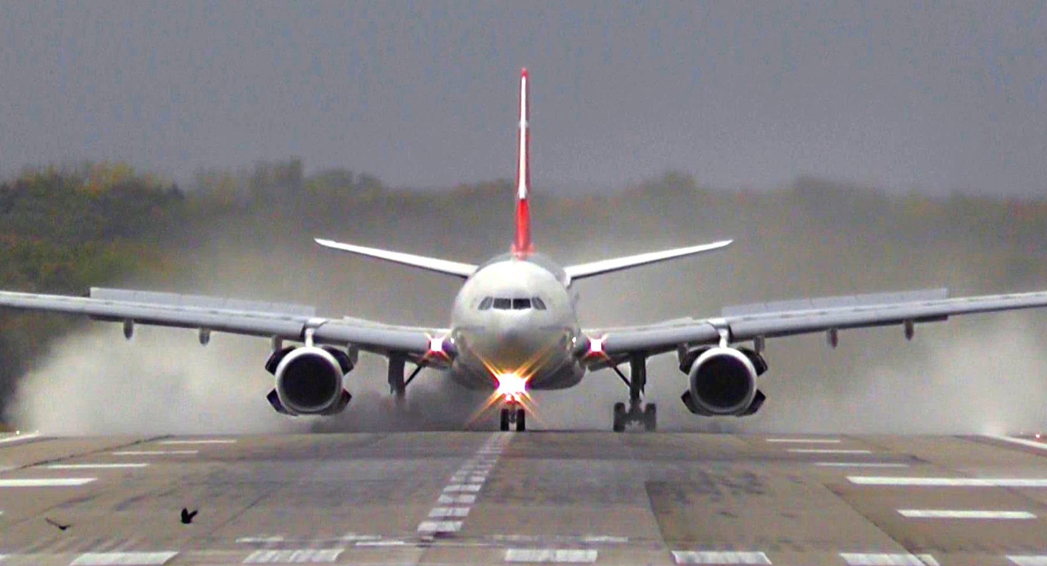
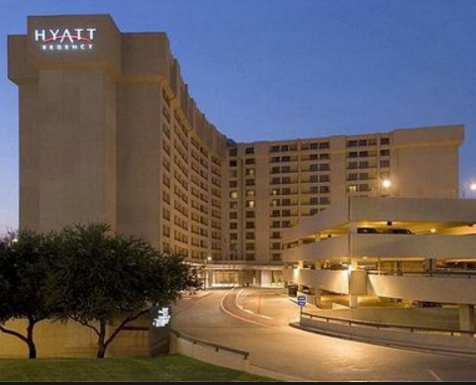
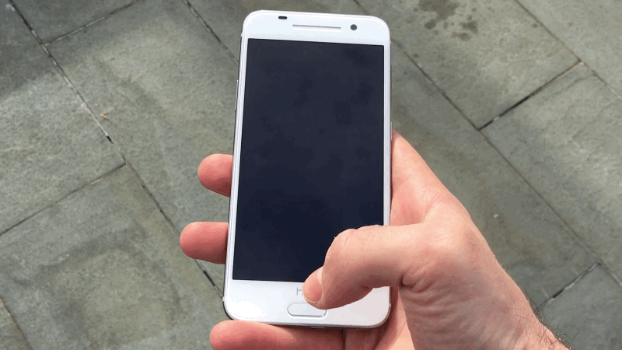

Push notification on arrival at Hotel

Slide 8
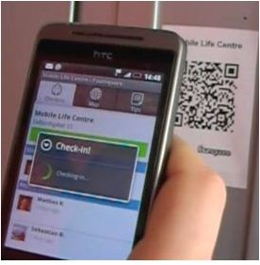
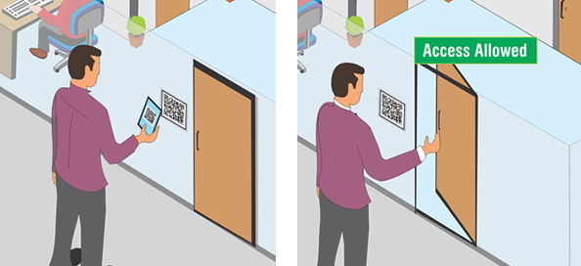

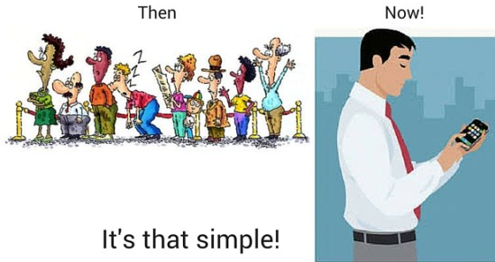
Automatic check-in & check-out

Slide 9
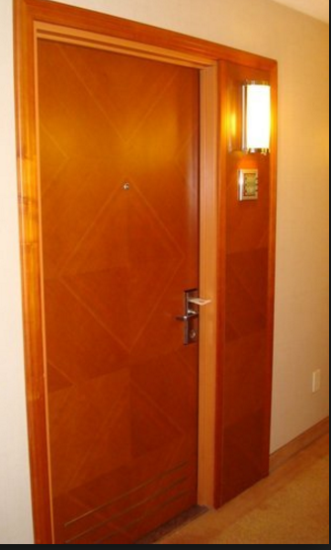
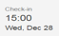
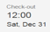
Scan your way to the room
Travel Mate

Slide 10
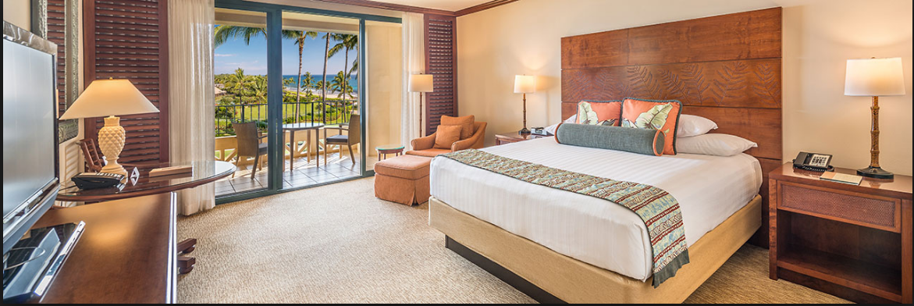
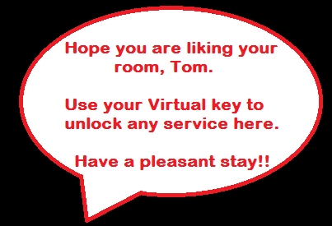
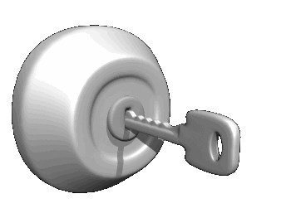
Virtual Key
Hotel authority has been notified and will be sending their staff to you

Slide 11

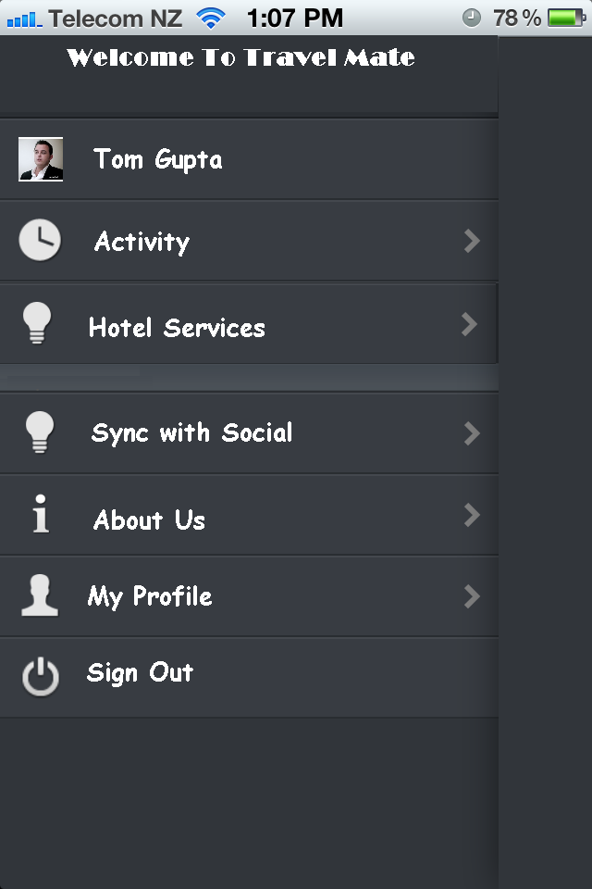


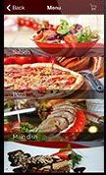




Intuitive hotel services
Hotel Services
Food
Room Service Food
Sightseeing Concerts

Slide 12
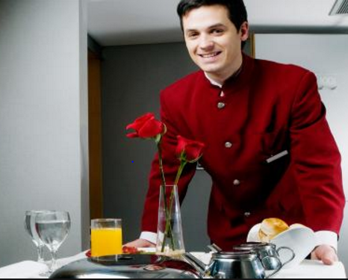

Service order verification

Slide 13
Impact and Applicability
It can be integrated with Trip Case ,GetThere or can go out as stand alone application
The idea can be extended by including Virtual Payments and receipt capture
Solutions to existing problems
It would let a tired traveler escape the manual check-in process
More intuitive way of using the hotel services
No worry of carrying a key or losing it

Slide 14
ROI
Customer :- Hotel authorities
Total booking in last 6 months:- 15000 (count)
Total hotel booking percentage :- 30% = 4500
Initial cost for Hotel authorities to get their services to the customer via app= $500
Per app check-in cost of $2 is charged to Hotel authorities
Assume 5% increase in bookings due to customer experience is $250* 750 (trips)= $187500
Total revenue:- 20(Top hotels)* 500+ (4500*2)+ (750*2)+187500= $206500 in 6 months
Total investment :- $156500

Slide 15
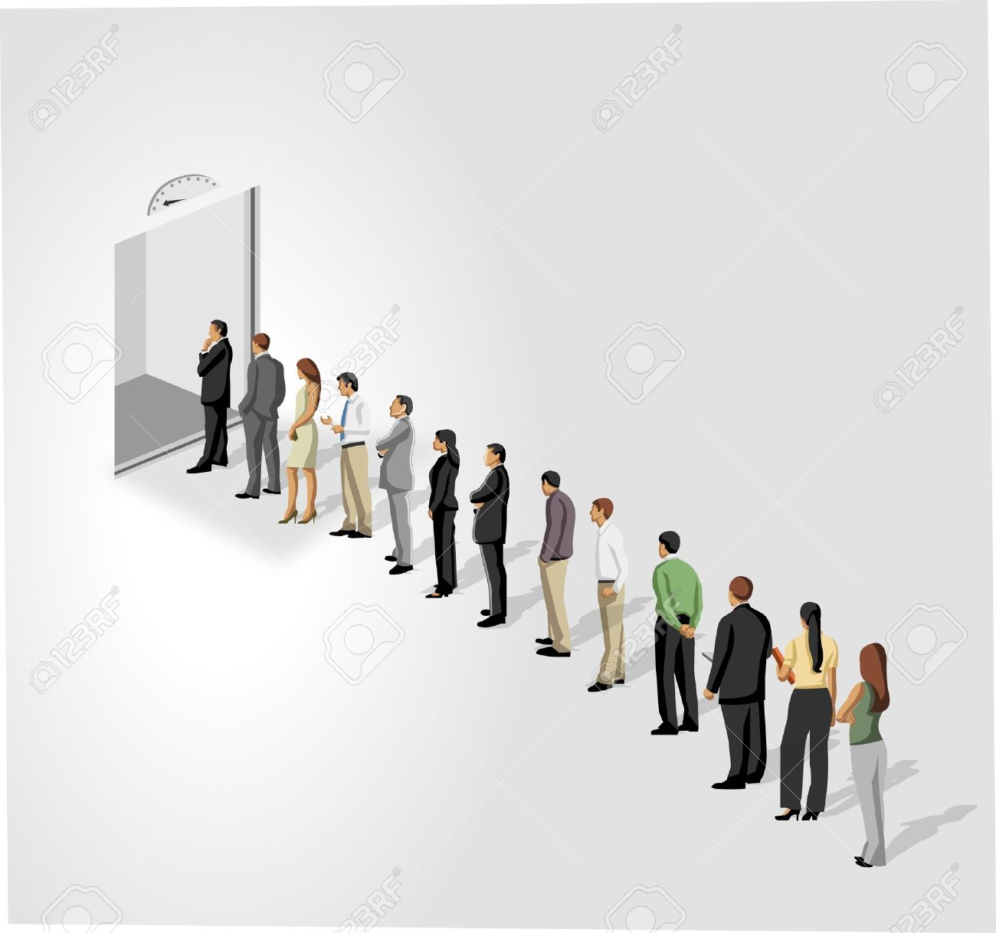



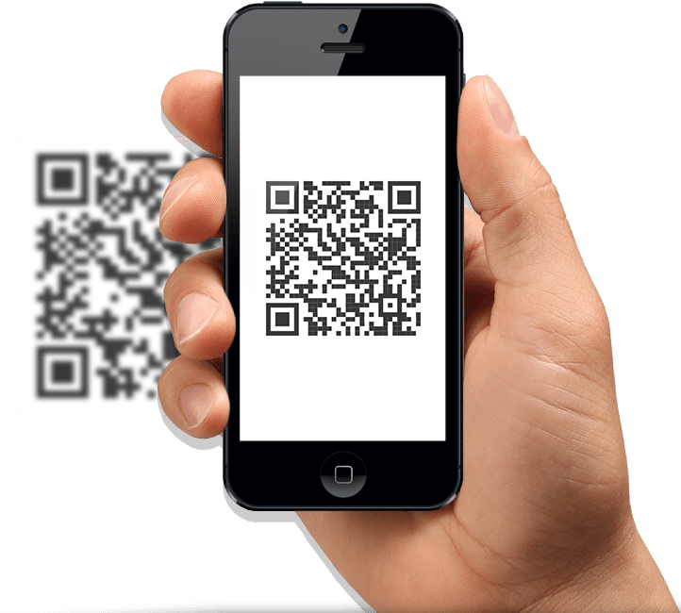
Benefits
Skip long queue
No hardware investments
Hotel service is just a click away
No fear of misplacing documents
Automatic
check-in
&check-out

